Slide 1
Software Guard eXtensions (SGX)

Slide 2
Operating Systems
Controls sharing of system resources
Enforces protection

Slide 3
Operating Systems
Controls sharing of system resources
Enforces protection
Can be compromised
Not always trustworthy

Slide 4

Operating Systems
Controls sharing of system resources
Enforces protection
Can be compromised
Not always trustworthy
And has superpowers

Slide 5

SGX

Slide 6

SGX (Software Guard eXtensions)
CPU hardware feature designed to allow (remote) secure computation
“Developers can partition their application into processor-hardened enclaves or protected areas of execution in memory that increase security even on compromised platforms. ”
“Confidentiality and integrity: Enforced at the operating system, BIOS, VMM, SMM, or TEE layers even in the presence of privileged malware.”
“Remote attest and provision: A remote party can verify an application enclave identity and securely provision keys and other sensitive data to the enclave”
Present on all Intel CPUs since 2016 (SkyLake)

Slide 7




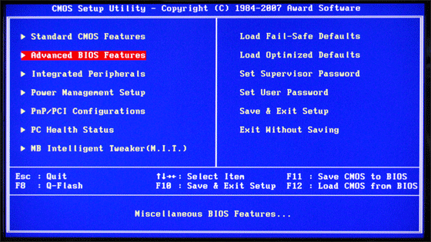
SGX Security Model
User Space
User Space
OS Kernel
OS Kernel
VMM
VMM
SMM
SMM
RAM
HW
CPU

Slide 8


SGX Security Model
User Space
Attestation
Enclave
OS Kernel
VMM
SMM
Remote
Client
RAM
HW
CPU

Slide 9
SGX Memory Management
Memory
Page Table
Enclave pages are encrypted and authenticated
OS allocates pages
Hardware verifies mapping
Abort page semantics
Secure page swap
SGX Memory
Admin
Enclave Page Cache (EPC)
EPCM
Merkle Tree
Enclave ID

Slide 10


SGX Security Model: The Fine Print
“Intel SGX does not provide explicit protection from side-channel attacks, it is the developer's responsibility to address side-channel attack concerns.”
Intel SGX Developer Guide, Page 39/40
You can’t break our side channel protections, if we don’t have any

Slide 11
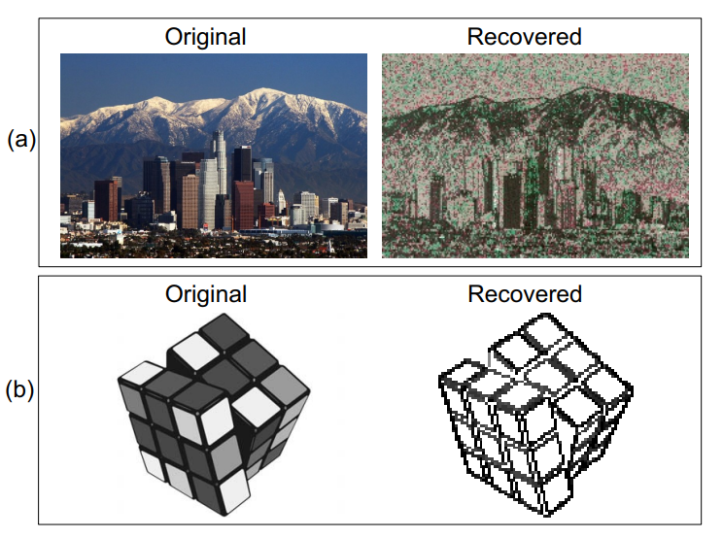
Controlled Channels Attacks (Xu et al. IEEE SP 2015)
PT
OS controls page table – marks all as invalid
Gets access on enclave interrupt
Trace page accesses
EPCM
Enc. ID

Slide 12
OS Control
Interrupts are not required (Van Bulck et al. USENIX Sec. 2017)
Monitor accessed and dirty bits on page tables
Cache attacks on PTEs
Isolate core
Fixed CPU frequency
Monitor performance counters
Timer interrupts

Slide 13
SGX Step (Van Bulck et al. SysTEX 2017)
Library for controlling SGX execution
Exposes page maps to user space
Exposes APIC interrupts to user space
Allows user control at enclave interrupts
High resolution, low noise microarchitectural attacks

Slide 14
Meltdown-type attacks

Slide 15
Out of Order Execution
CPU
load base, r1
load height, r2
mul r1, r1, r3
mul r2, r2, r4
add r3, r4, r3
sqrt r3, r3
store r3, hypotenuse
mul r1, r2, r3
div r3, 2, r3
store r3, area
r1:
r2:
r3:
r4:

Slide 16
Out of Order Execution
CPU
load base, r1
load height, r2
mul r1, r1, r3
mul r2, r2, r4
add r3, r4, r3
sqrt r3, r3
store r3, hypotenuse
mul r1, r2, r3
div r3, 2, r3
store r3, area
r1:
r2:
r3:
r4:
Start executing first load load

Slide 17
Out of Order Execution
Suppose height is in the cache and second load terminates first
CPU
load base, r1
load height, r2
mul r1, r1, r3
mul r2, r2, r4
add r3, r4, r3
sqrt r3, r3
store r3, hypotenuse
mul r1, r2, r3
div r3, 2, r3
store r3, area
r1:
r2:
r3:
r4:
Start executing second load

Slide 18
Out of Order Execution
CPU
load base, r1
load height, r2
mul r1, r1, r3
mul r2, r2, r4
add r3, r4, r3
sqrt r3, r3
store r3, hypotenuse
mul r1, r2, r3
div r3, 2, r3
store r3, area
r1:
r2:
r3:
r4:
Start executing the multiply instruction

Slide 19
Out of Order Execution
CPU
load base, r1
load height, r2
mul r1, r1, r3
mul r2, r2, r4
add r3, r4, r3
sqrt r3, r3
store r3, hypotenuse
mul r1, r2, r3
div r3, 2, r3
store r3, area
r1:
r2:
r3:
r4:
When the first load completes

Slide 20
Out of Order Execution
CPU
load base, r1
load height, r2
mul r1, r1, r3
mul r2, r2, r4
add r3, r4, r3
sqrt r3, r3
store r3, hypotenuse
mul r1, r2, r3
div r3, 2, r3
store r3, area
r1: 4
r2: 3
r3:
r4:
retire all completed instructions

Slide 21
Out of Order Execution
CPU
load base, r1
load height, r2
mul r1, r1, r3
mul r2, r2, r4
add r3, r4, r3
sqrt r3, r3
store r3, hypotenuse
mul r1, r2, r3
div r3, 2, r3
store r3, area
r1: 4
r2: 3
r3:
r4:
… and proceed
Why not retire out-of-order?

Slide 22
Why not retire early
Early retire stores a result in the architectural state
CPU
load base, r1
load height, r2
mul r1, r1, r3
mul r2, r2, r4
add r3, r4, r3
sqrt r3, r3
store r3, hypotenuse
mul r1, r2, r3
div r3, 2, r3
store r3, area
r1:
r2: 3
r3:
r4:

Slide 23
Why not retire early
Early retire stores a result in the architectural state
CPU
load base, r1
load height, r2
mul r1, r1, r3
mul r2, r2, r4
add r3, r4, r3
sqrt r3, r3
store r3, hypotenuse
mul r1, r2, r3
div r3, 2, r3
store r3, area
r1:
r2: 3
r3:
r4:
A later fault leaves the processor in an inconsistent state!

Slide 24
Traps in Out of Order Execution
Suppose height is an invalid address
CPU
load base, r1
load height, r2
mul r1, r1, r3
mul r2, r2, r4
add r3, r4, r3
sqrt r3, r3
store r3, hypotenuse
mul r1, r2, r1
div r1, 2, r1
store r1, area
r1:
r2:
r3:
r4:
Start executing second load

Slide 25
Traps in Out of Order Execution
CPU
load base, r1
load height, r2
mul r1, r1, r3
mul r2, r2, r4
add r3, r4, r3
sqrt r3, r3
store r3, hypotenuse
mul r1, r2, r3
div r3, 2, r3
store r3, area
r1:
r2:
r3:
r4:
Mark as an error, but continue executing until all older instructions retire

Slide 26
Traps in Out of Order Execution
CPU
load base, r1
load height, r2
mul r1, r1, r3
mul r2, r2, r4
add r3, r4, r3
sqrt r3, r3
store r3, hypotenuse
mul r1, r2, r3
div r3, 2, r3
store r3, area
r1: 4
r2:
r3:
r4:
Raise Trap
Mark as an error, but continue executing until all older instructions retire

Slide 27
Traps in Out of Order Execution
CPU
load base, r1
load height, r2
mul r1, r1, r3
mul r2, r2, r4
add r3, r4, r3
sqrt r3, r3
store r3, hypotenuse
mul r1, r2, r3
div r3, 2, r3
store r3, area
r1:
r2:
r3:
r4:
Mark as an error, but continue executing until all older instructions retire
But while we’re waiting…
Dependent instructions
Start executing

Slide 28
Traps in Out of Order Execution
CPU
load base, r1
load height, r2
mul r1, r1, r3
mul r2, r2, r4
add r3, r4, r3
sqrt r3, r3
store r3, hypotenuse
mul r1, r2, r3
div r3, 2, r3
store r3, area
r1:
r2:
r3:
r4:
Mark as an error, but continue executing until all older instructions retire
But while we’re waiting…
Dependent instructions
Start executing

Slide 29
Load instructions
Virtual Address
Execution Engine

Slide 30
Load instructions
Execution Engine
Physical Address
Virtual Address
Memory Pipeline
L1 Cache
Data
L2 Cache

Slide 31
Load instructions
Execution Engine
Physical Address
Virtual Address
Memory Pipeline
L1 Cache
Data
L2 Cache

Slide 32

Using a Covert Channel
i = *pointer;
y = array[i * 4096];
3
Cache
array
pointer
3
The number of the day

Slide 33

Using a Covert Channel
It is 3!
i = *pointer;
y = array[i * 4096];
3
Cache
array
pointer
3

Slide 34

Meltdown

Slide 35
Meltdown
i = *pointer;
y = array[i * 4096];
3
Cache
array
pointer
Kernel space (protected)

Slide 36
Meltdown
It is 3!
i = *pointer;
y = array[i * 4096];
3
Cache
array
pointer
Kernel space (protected)

Slide 37

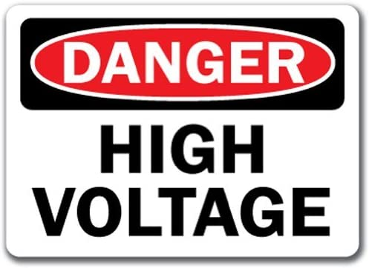
Handling Faults
A fault kills the process. How do we recover the channel?
Spawn a new process
Use a signal handler
?

Slide 38
Fault suppression
if (train) {
a = *ptr
b = array[a * 4096]
}
if (_xbegin() == _XBEGIN_STARTED) {
a = *ptr
b = array[a * 4096]
_xend()
}

Slide 39
Meltdown Countermeasure - KPTI
Use a separate address space for the kernel
Overhead when crossing address space
Newer processors transiently return 0
Kernel space (protected)
Process
Mapping of process
Kernel

Slide 40

Foreshadow

Slide 41



Meltdown on Enclaves
virtual memory
I’m still alive?!
pointer
no leakage
Attackers data
array2[4096]
array2[8192]
array2[12288]
i = *pointer;
y = i * 4096;
z = array2[y];
…
array2
3
L1 Cache
-1
EPC
AES
Abort Page Semantics
Enclave data
(=3)

Slide 42




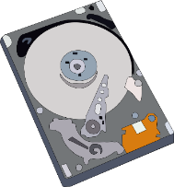
Foreshadow
virtual memory
Aha! data=3
pointer
array2[4096]
Attackers data
array2[8192]
array2[12288]
i = *pointer;
y = i * 4096;
z = array2[y];
array2
3
L1 Cache
3
L1 hit
EPC
Address translation failed
Instruction flagged to fault at retirement
No need to apply permission checks (abort page semantics) as instruction will fault later anyway
AES
Enclave data (=3)
3
mprotect(…)

Slide 43
Foreshadow-OS (Weisse et al. 2018)
Disk
Stale reference remains after page out
Data cached in L1 can leak
Countermeasure: Invert bits in page entry
Page Table
Memory

Slide 44

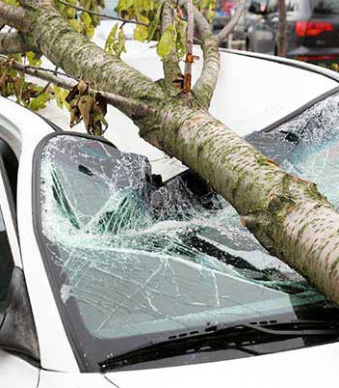

Philosophy 101
SGX
If a tree falls and no one is around to hear it, does it make a sound?
Should we care?
Well, it depends…

Slide 45



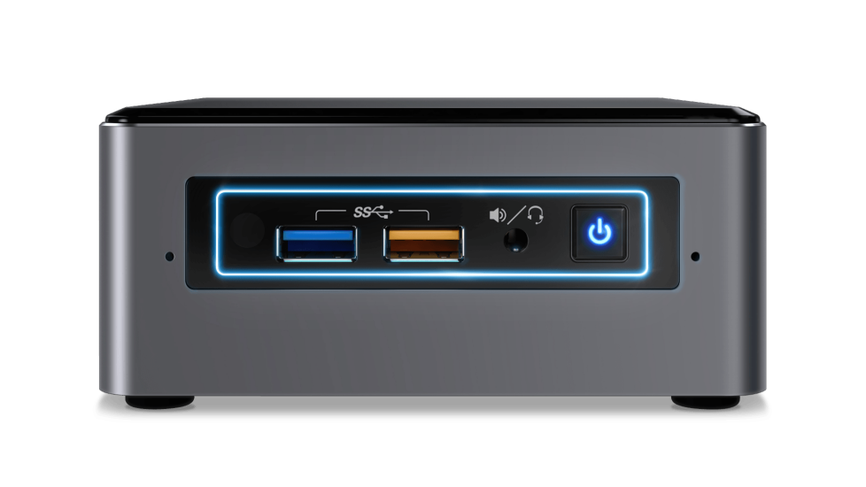
Security 101
If a machine was hacked,
no one knows,
and there is no data on it…
SGX Machine
Should we care?

Slide 46


Foreshadow
Can steal ~100% of the data ~100% of the time
Can also steal attestation EPID private keys

Slide 47












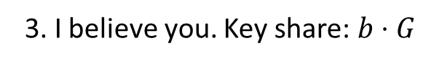
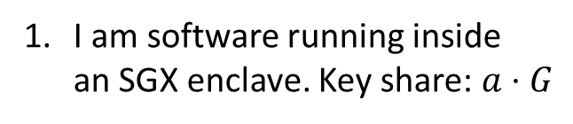
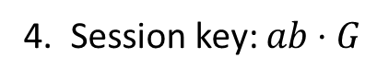
Remote Attestation: Establishing Trust Remotely
I am software running inside an SGX enclave. Key share: $a⋅G$
Client
quote
quote
Verify Quote with Intel
3. I believe you. Key share: $b⋅G$
4. Session key: $ab⋅G$
EPID key
Takeaway: trust is based on the EPID key
Intel Attestation Service
(IAS)

Slide 48



With a Enhanced Privacy comes Enhanced responsibility
Enhanced Privacy ID
EPID epic feature: privacy guarantees
Million signatures are unlinkable
No one knows who signed what
A single extracted EPID key can be used to sign millions of unlinkable signatures
One compromised key erodes trust in the entire ecosystem

Slide 49
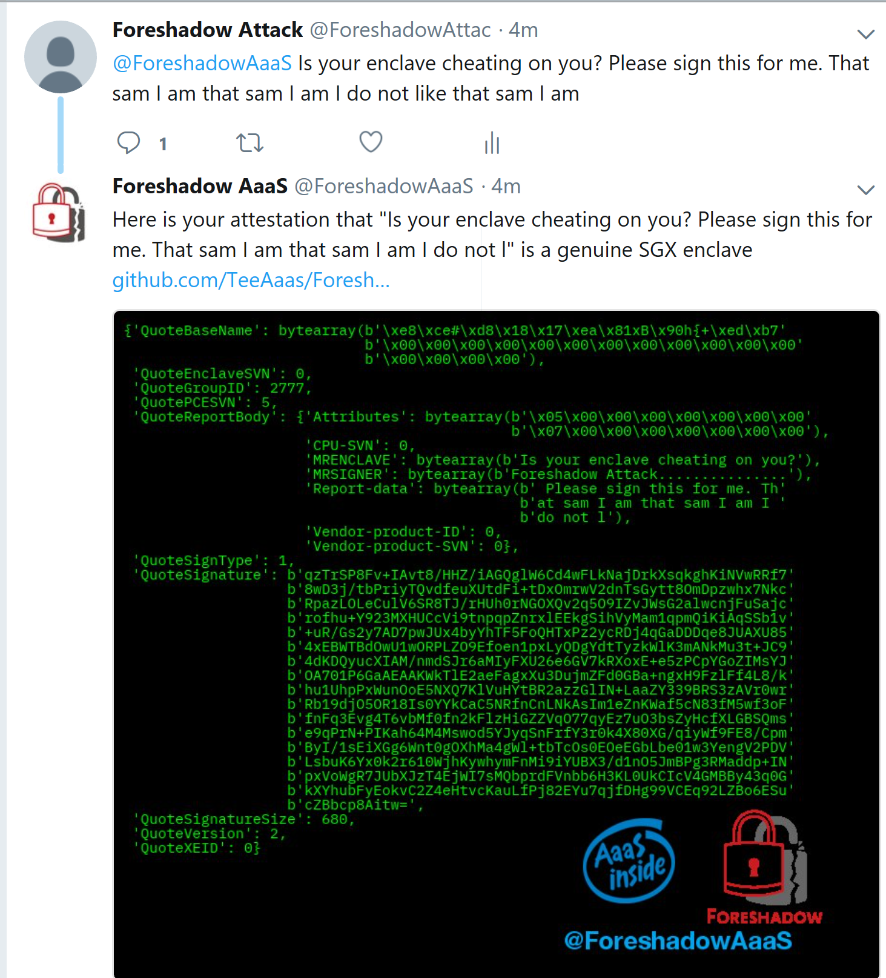

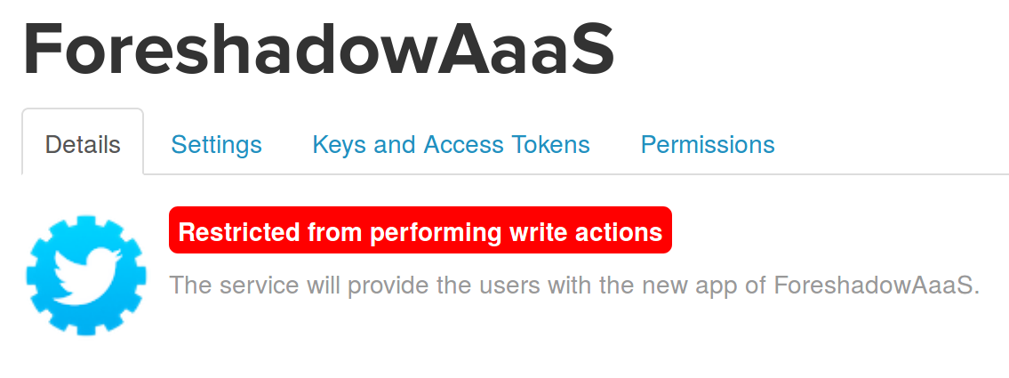
AaaS (Attestation as a Service)
@ForeshadowAaaS Will attest to anything tweeted at it
Reduced cost of hackership – no need to buy an SGX machine
Hacker’s privacy guaranteed by EPID protocol
Attestation server returns Group_Out_Of_Date
At disclosure, SGX Keys were still not revoked (despite weeks of advances notice)
Blocked by Twitter

Slide 50
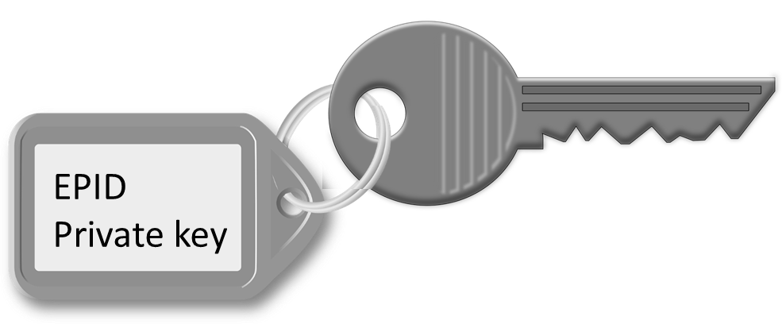


Foreshadow Mitigations
Flush L1 Cache after enclave exits and “page-in/out” operations
New L1 flush “instruction” added
Disable HyperThreading
Have two sets of Attestation/Sealing keys
For HyperThreading On/Off
Patch your machine!
Core 1
L1 Cache
Core 2

Slide 51
Foreshadow-VMM (Weisse et al. 2018)
Invalid guest mappings transiently use the guest physical address
Countermeasure
Flush L1-D on VM exits
Disable hyperthreading or use gang scheduling
Virtual Machine
Page Table
EPT
Memory

Slide 52

Microarchitectural Data Sampling

Slide 53
What if the data is not in the cache?
Execution Engine
Physical Address
Memory Pipeline
Line Fill Buffers
L1 Cache
Physical Address
Data
Data
L2 Cache
Data

Slide 54

Microarchitectural Data Sampling (MDS)
Countermeasure:
Prevent access to sensitive data
Flush buffers containing sensitive data
Zero sensitive data
Data leaks not only from the cache
There are multiple buffers that can leak information
Line fill buffers – used when filling the cache
Store buffers – reorder load and store instructions
Load Ports – some other cases
Bonus: traps are not necessary
Microcode assists
TSX abort
Execution Engine
Store Buffers
Memory Pipeline
Line Fill Buffers
L1 Cache
L2 Cache

Slide 55


CacheOut and CrossTalk
We can move data to buffers after they are flushed
CacheOut:
L1 eviction go to the line fill buffers
Revives Foreshadow
CrossTalk:
Can read from a staging buffer via the line fill buffers
Can steel randomness from SGX enclave
Execution Engine
Store Buffers
Memory Pipeline
Line Fill Buffers
L1 Cache
L2 Cache
CrossTalk
Last Level Cache
Staging Buffer

Slide 56
Summary
SGX
Strong security guarantees against OS attackers.
Enables strong side channel attacks
Causes of Meltdown-type attacks
Handling faults
Where information comes from
Some defences
Reading for next week:
Tian et al., SoK: “Plug & Pray” Today – Understanding USB Insecurity in Versions 1 through C, IEEE SP 2018

